Slide 1
Building Apps and Services for Azure Marketplace & AppSource
Keith Vidal, Director, Marketplace
<Cloud+AI Engineering>

Slide 2
Agenda
One Cloud Marketplace: 2 Storefronts
Azure Marketplace
AppSource
Participating in the Marketplace
Exploring Marketplace Capabilities:
SaaS Applications
Private Offers
Containers
Consulting Services
Get Started

Slide 3

Adoption of application marketplaces by organizations will likely rise from 29% to 75% in 2 years.
Source: Forrester Consulting on behalf of Microsoft, April 2017
Notes:
Talking points:
As organizations embrace cloud apps, business users take greater ownership of app discovery and deployment
Organizations anticipate saving time and money and improving customer and end user experiences with an app marketplace
In the past year, 78% of business users have used full or trial versions of business apps without IT’s involvement
Business leaders want greater oversight and involvement from their IT teams to ensure successful app deployments
Application marketplaces need to be rich, versatile, and personalized, with management and search capabilities
If you aren’t using marketplaces today, you’re already behind.
Choose wisely to avoid unnecessary overhead and complexity
Look to existing marketplaces to offload tasks and tap into world-class resources
Consider how homogenous or heterogenous your environment is when picking the right approach

Slide 4
Grounding Principles
Parity Between Partner and Microsoft Products
Marketplace as a Behavioral Pattern
Notes:
These are our grounding principles and concepts for Modern Development and where we are taking our modern commercial engineering. Two big bets at the Satya level.
1) Parity in how we sell 3rd party apps and solutions and 1st party solutions. If we don’t have parity or become able to put 3rd party in front when that’s what’s best for the customer, we will not be successful in a consumption based world
Need to be effective at selling third party solitons –
Modern commerce stack is the promise of this
Data warehouse for first and 3rd party services
Creating partner SKUs
2) Grounding principle 2
Marketplace UI should be as consistent and familiar as search – which always the same and across all browsers and formats etc
Customers and partners can find the things they need and it doesn't matter if its partner or Microsoft
Tasked teams to come together to have a consistent way to make marketplace a behavioral pattern
Both things accrue to our charter and to ensure we are prioritizing our partner solutions.
We are not “partner-led” until we are able to put partners out in front, and showcase partners before we show ourselves

Slide 5
1 cloud marketplace : 2 storefronts

Slide 6
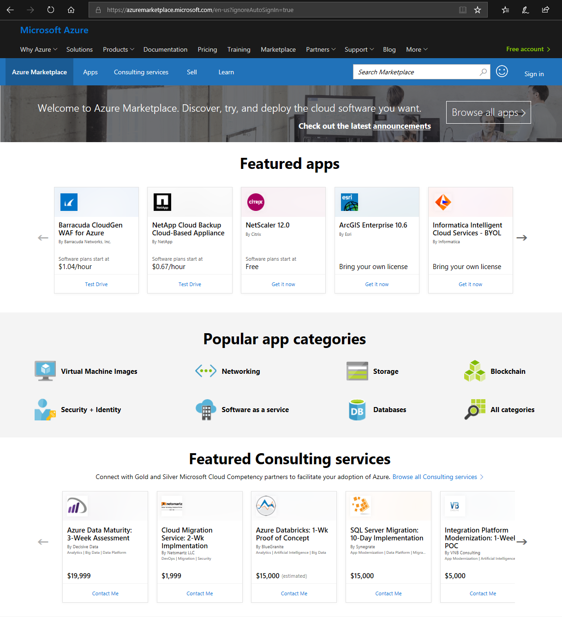
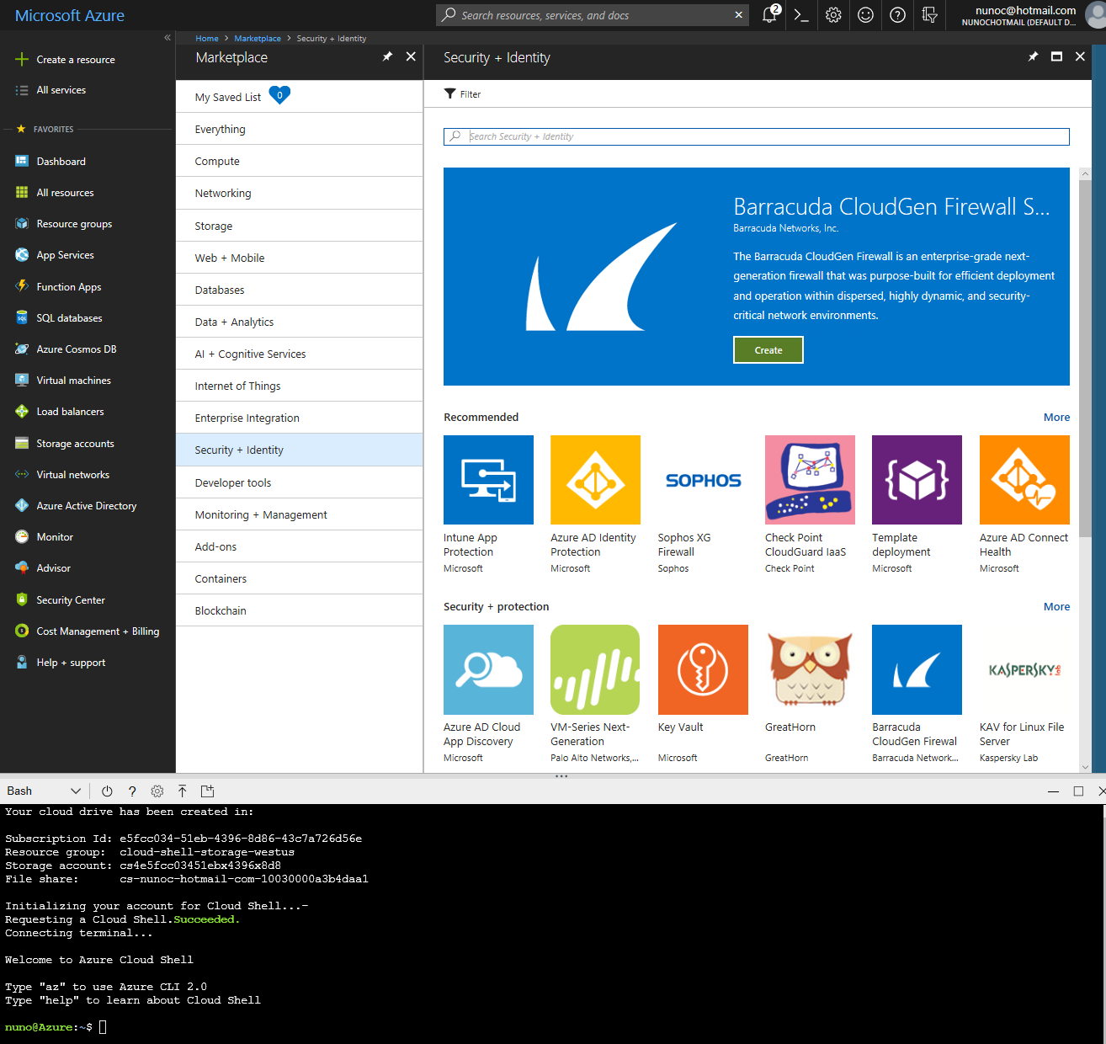
Azure Marketplace
Discover, try and deploy the cloud software you want

Slide 7
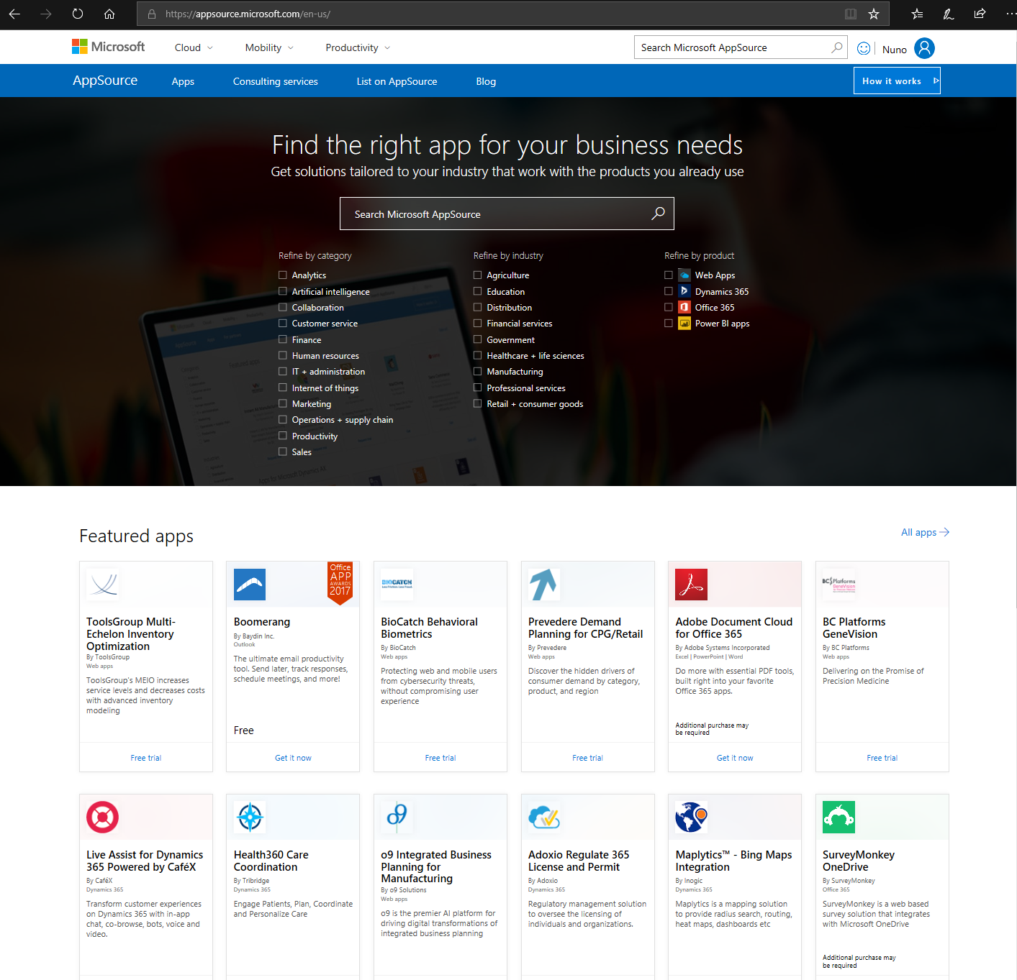
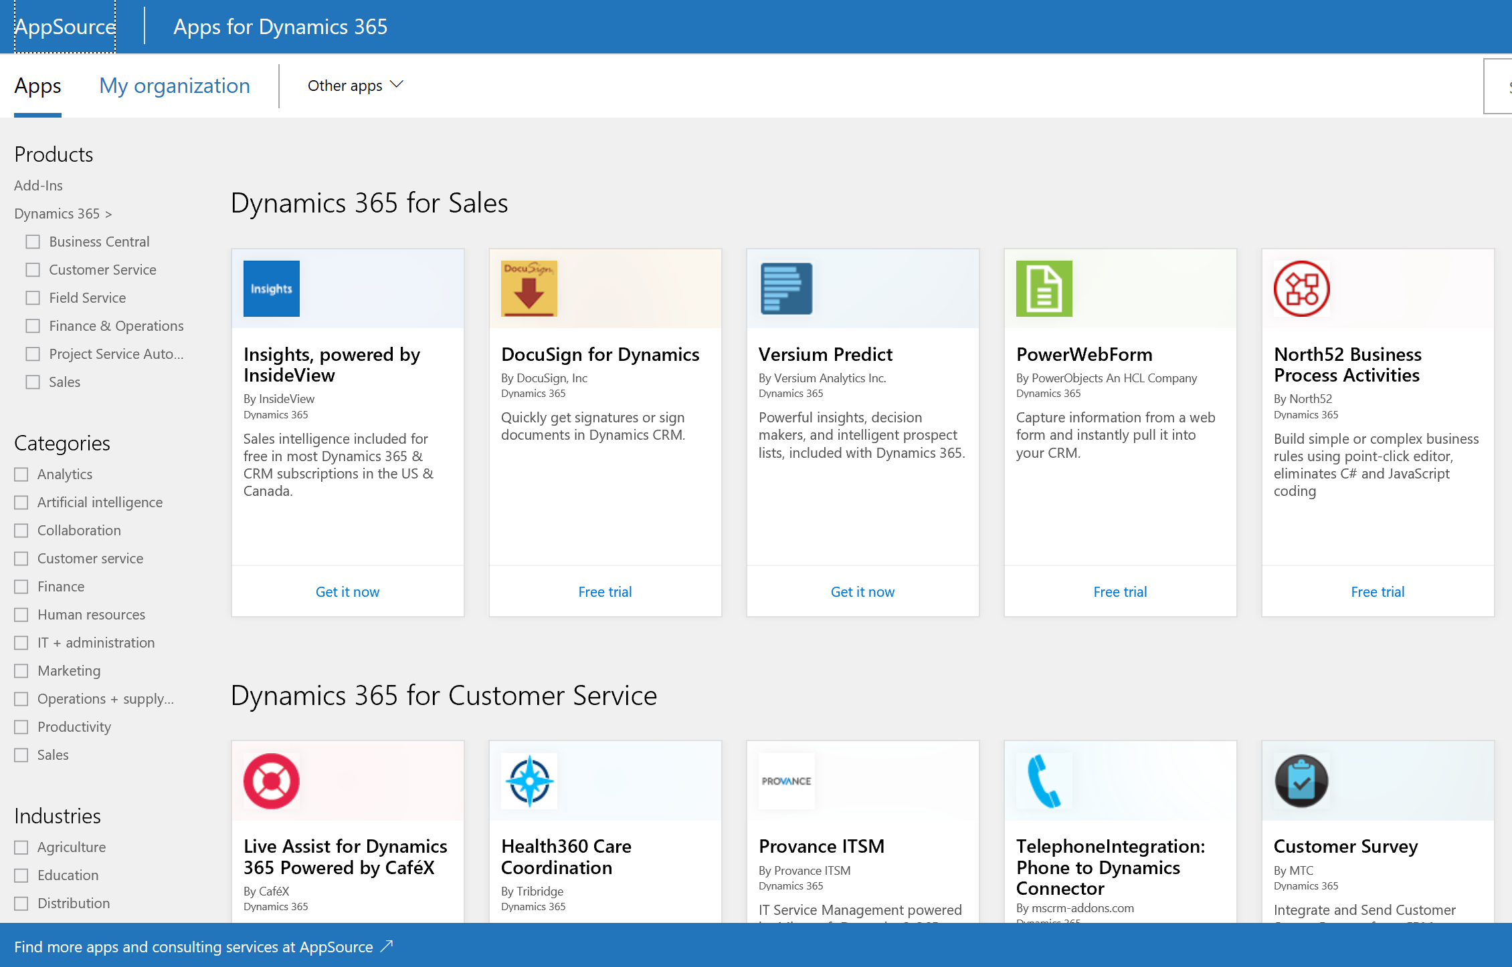
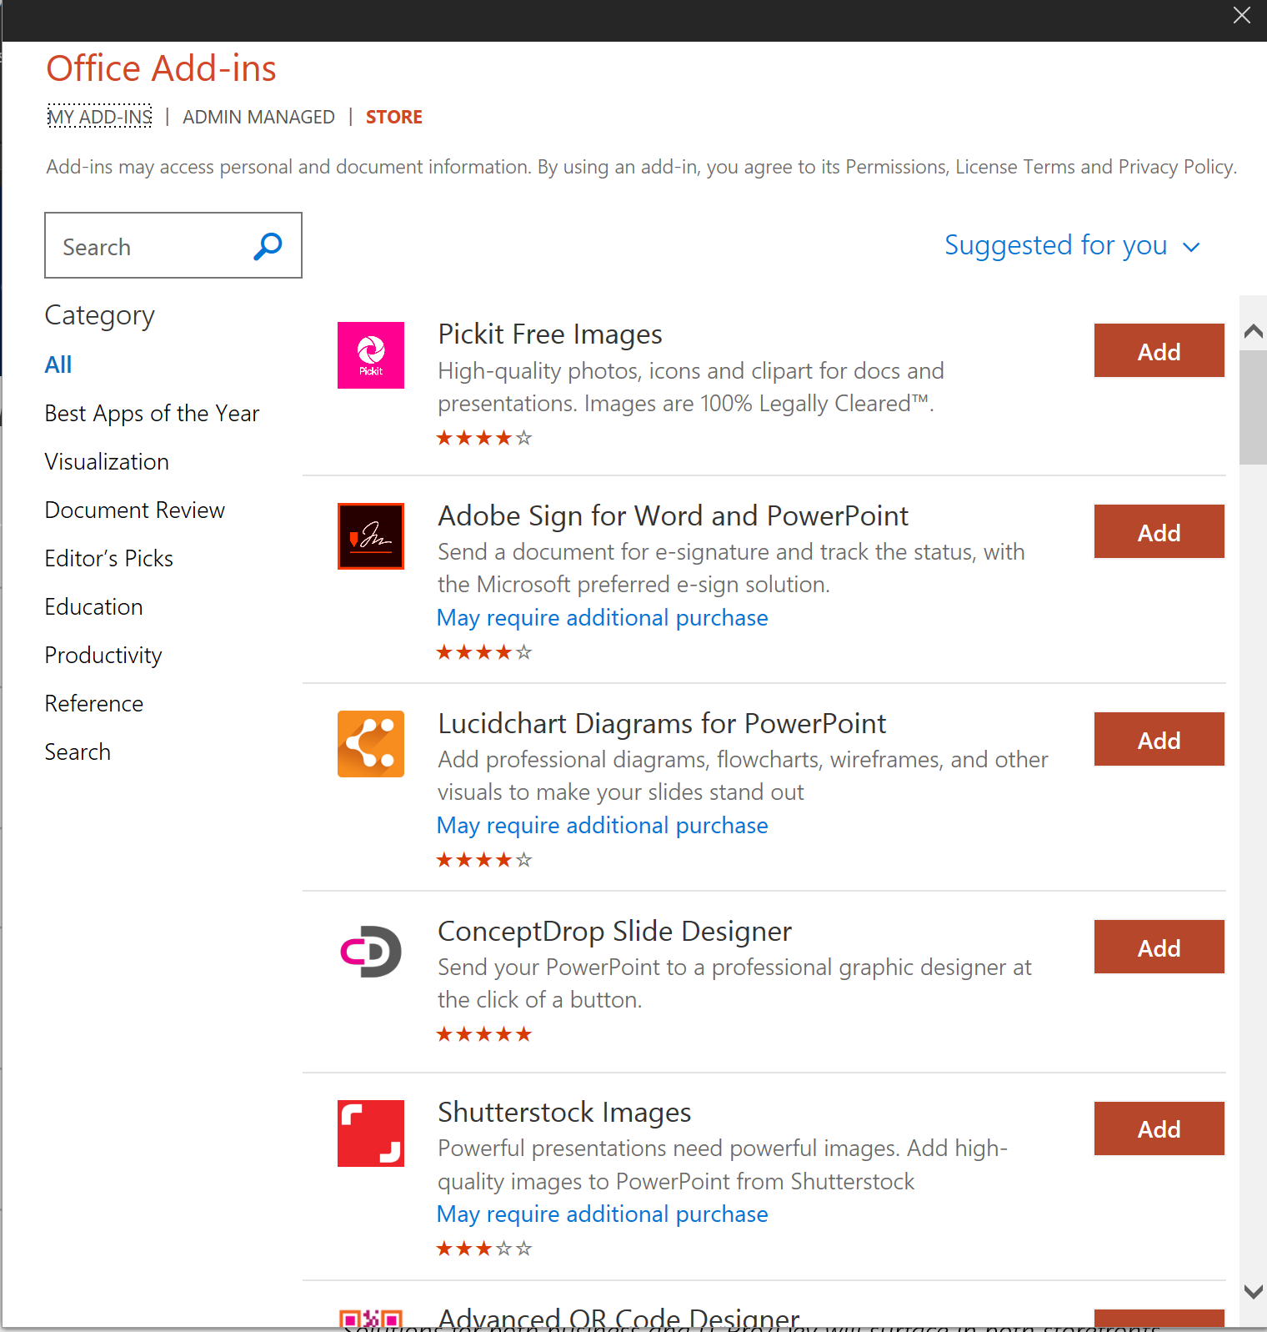
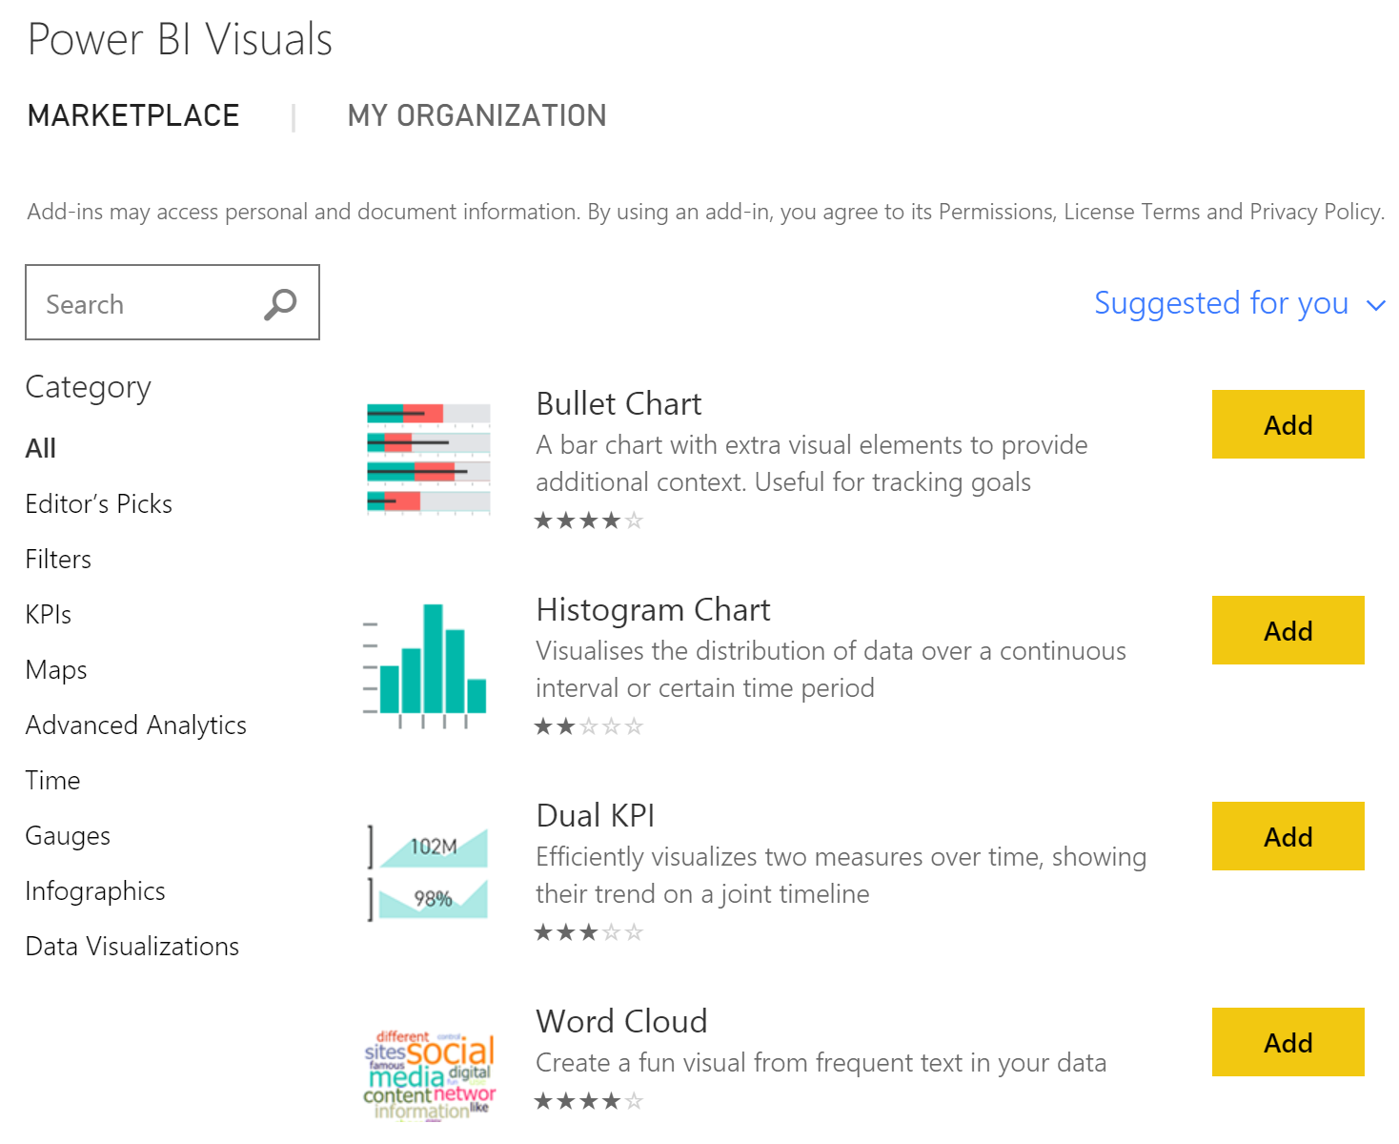
AppSource
Get solutions tailored to your industry that work with the products you already use

Slide 8
One Cloud Marketplace, Two Storefronts Where Customers can find, try and buy/deploy industry leading cloud solutions from Microsoft Partners
Azure Marketplace
AppSource
Audience
IT Pros and Cloud Developers
Business Users
Azure building blocks and finished software solutions
Industry focused line-of-business and productivity apps
Solution Type
Consulting Services
Azure
Power BI , Dynamics 365
Dynamics 365, Office 365, Office Client Apps, Power BI
In Product Experience
Azure Management Portal
Publishing Options
List, Trial or Transact
List or Trial
Publisher Experience
Cloud Publisher Portal
Solutions for both business and IT Pro/Dev can surface in both storefronts

Slide 9
A Growth Lever For Your Business Cloud marketplace is the launch pad for joint go-to-market with Microsoft
Promotion
Momentum
Access
8,000+ Listings
2M+ Active Users/Month
New Features and Offers
120,000 Enterprise Customers
300K+ Ecosystem Partners
Available In 141 Countries
LAUNCH
Cloud Marketplace
Marketing
Sales
GROW
MARKET
Launch Promotion
Joint Marketing
Lead Sharing and Qualification
Joint Selling
Incentives To Sell Your Service
Joint Sales + Marketing
Demand Gen

Slide 10























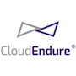







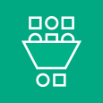







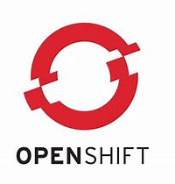








Azure Marketplace – Market Leading Solutions
OS
Security, Identity Networking
Data+Analytics
Storage, Backup, DR
DevOps, Management, Containers
BlockChain
CentOS
Debian
Ubuntu
YOUR LOGO HERE
Aqua
Barracuda
Check Point
Fortinet
Palo Alto Networks
YOUR LOGO HERE
Elastic
Hortonworks
Qubole
Splunk
Tableau
YOUR LOGO HERE
SoftNAS
HPE
YOUR LOGO HERE
Bitnami
GitHub
Jenkins
Mesosphere
Puppet
Terraform
YOUR LOGO HERE
BlockApps
Chain
Enterprise Ethereum Alliance
Emercoin
Ethereum
R3

Slide 11

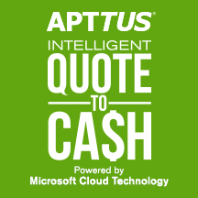






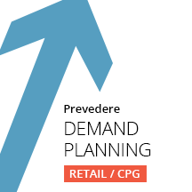
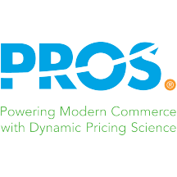































AppSource - Industry and Productivity
SaaS
Office 365
Dynamics 365
Power BI
YOUR LOGO HERE
Avepoint
YOUR LOGO HERE
ToolsGroup
Temenos
Zoho
YOUR LOGO HERE
Boomerang
Evernote
HubSpot
Nintex
Trello
Yesware
YOUR LOGO HERE
Adobe
CaféX
CloudFronts
Tribridge
Versium Analytics
YOUR LOGO HERE
DevScope
Asana
ClickDimensions
Office365Mon
Webtrends

Slide 12
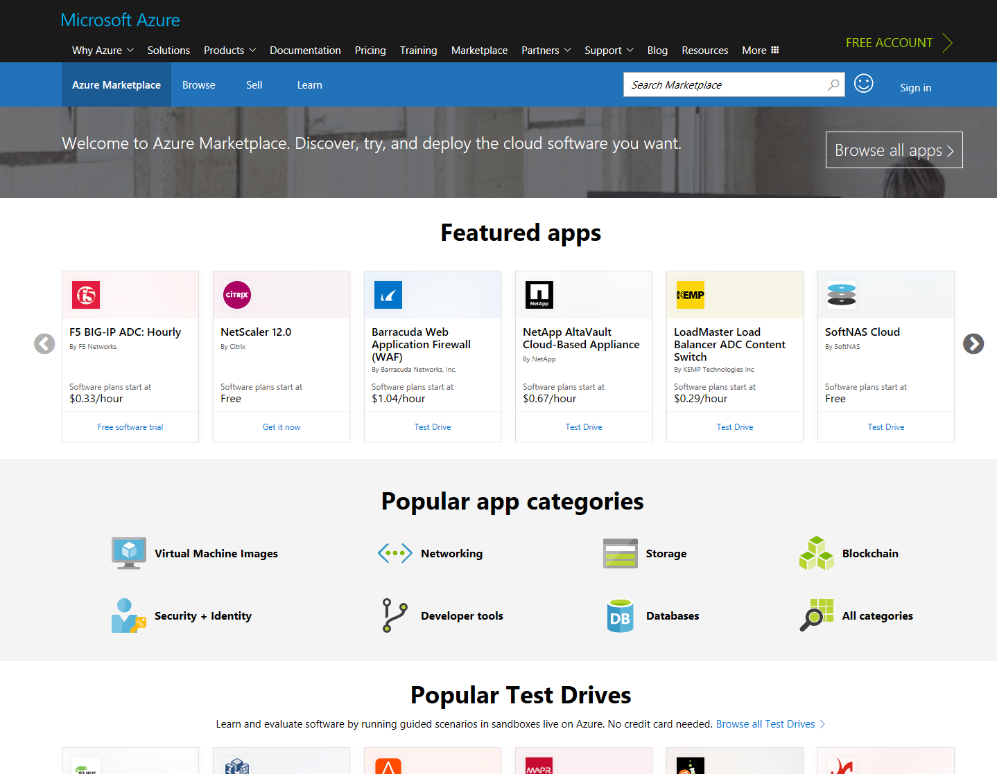


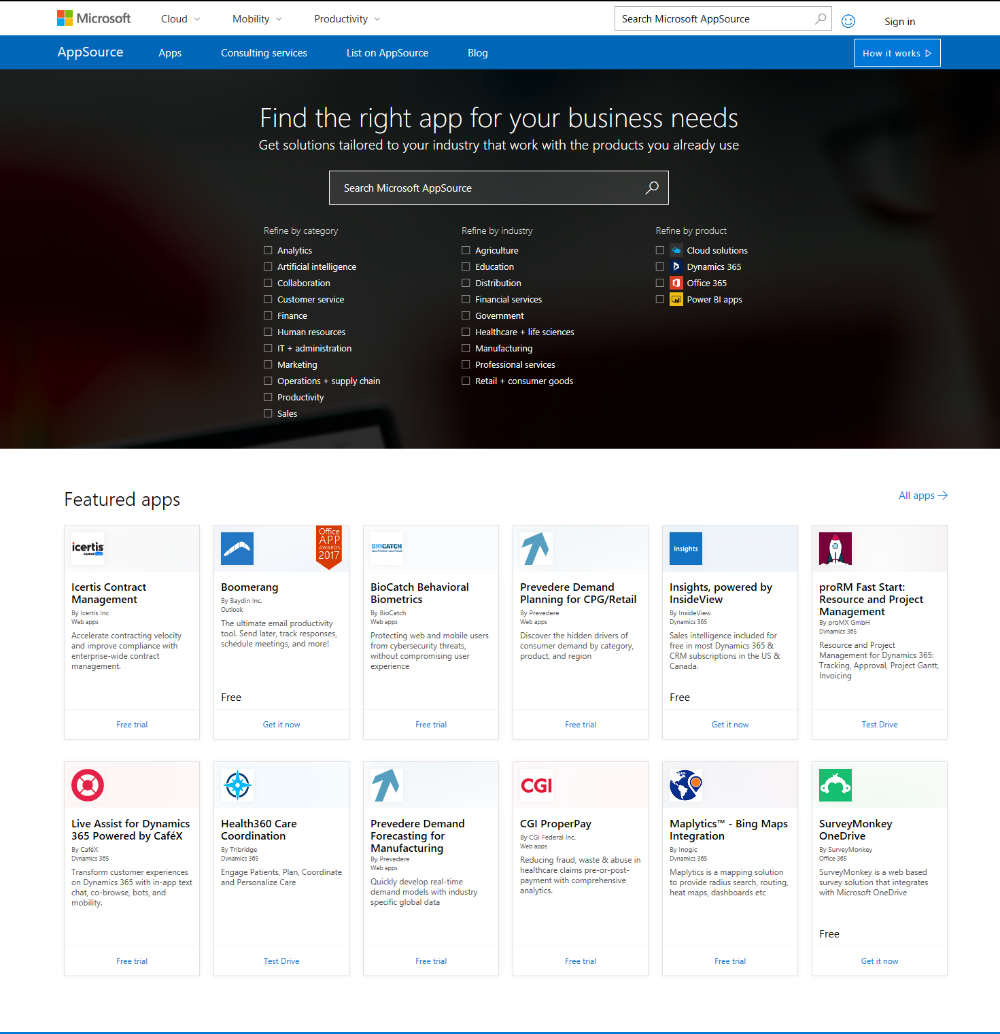
Marketplace Flow
Marketplace
PUBLISH APP
1
C1
Get it Now
Customer
App Provisioned
Invoicing* & Billing*
C2
C3
Lead, Order, Payouts*
ISV.com
ISV
Trial Experience
B1
Free Trial
B2
Lead and Trial redirect
Provision User Trial
Nurture Opportunity
B3
A1
Contact Me
Lead
A2
Contact User
Nurture Opportunity
A3
* Only for Paid Apps

Slide 13
Marketplace Publishing Options Choose the ideal publishing option based on how you sell your solution
LIST
TRIAL
TRANSACT
1
2
3
SaaS
Limited Use/Duration Account
Guided Trial Experience
Test Drive (sandbox)
Add-in – Get Free
Virtual Machines
Azure Managed Apps
Azure Solution Templates
Containers (new)
SaaS Subscriptions (new)
Option
“Contact Me” for
SaaS and Consulting Services
Requirement
Customer-Ready App or Offer
No Technical Requirements
IaaS – Azure Certification
SaaS – Subscription API
SaaS - Azure Active Directory
Notes:
Talking points:
We want every partner to choose at least publishing option such that relevant solutions can be listed in Marketplace with minimal additional engineering resources; all partners will get access to lead sharing, available with each publishing option
Publishers can get value from Marketplace at any level of participation; publishers that participate more deeply will get access to additional Marketplace capabilities, like deployment automation and commerce in the Transact scenario, and many partners will be eligible for additional GTM investment based on solution impact
Listing types are available for each storefront unless otherwise noted
When the publisher offers multiple solutions, apps, or services, one or any combination of publishing options and listing types can be used
AppSource is not enabled for commerce today; Only the AMP/TRANSACT scenario is enabled for commerce
“Azure Certified” validation, testing and certification is only available in the TRANSACT scenario

Slide 14
Marketplace Benefits Overview Benefits are FREE to all publishers and new offers.
 | Eligibility Matrix
 | List | Trial | Transact
Technical
Onboarding | • | • | •
Technical Support | • | • | •
Application Design+Architecture |  |  | •
Azure Sponsorship for Dev/Test |  |  | •
Co-Market
GTM Launch Fundamentals | • | • | •
Microsoft Marketing Campaign Inclusion |  | • | •
Merchandising and MSFT Sites Promotion |  | • | •
Co-Sell
Azure Sponsorship for Customer Trials/POC | • |  | •
Marketplace Co-sell Leads Qualification |  | • | •
Co-Sell White Glove Onboarding (Startups) | • | • | •

Slide 15

AZURE MARKETPLACE
PARTNER REFERENCE
“The opportunities resulting from the thousands of Azure marketplace leads when Chef and Microsoft partner to co-sell a deal, the agreements close 25% faster than average.
In short, Azure Marketplace is great for Azure customers and partners alike.”
Chef Software, Inc.
Chef Software is global provider of solutions to build end-to-end server and deployment tools. Founded in Seattle, WA in 2008, Chef enable collaboration and continuous automation across your infrastructure, applications, and compliance for all apps and infrastructures.
Vikram Ghosh,
Vice President of Cloud Partners
Chef Software, Inc.
VIEW THE CUSTOMER STORY

Slide 16
Marketplace New Investments
Offer Types
Enterprise Purchasing
Office Applications
Consulting Services
(Azure, Power BI, Dynamics)
Azure Managed Apps
Containers
SaaS Applications
Private Offers
SaaS Subscriptions
Publishers Experience
Partner Insights
APIs for publishing offers
More investments coming soon

Slide 17
SaaS Applications
Notes:
SaaS filter
SaaS trial (Apptimized, Kensci, biocatch?)
SaaS Subscription (CloudEndure, covenant technologies, Acqua)

Slide 18
SaaS Applications
Customer
ISV
What
What
Find apps that meet your needs
Try before you buy
Subscribe and integrate billing
List, offer trials or monetize applications
Integrate with your trial experience
Transact: simple, flat monthly pre-paid billing
Benefits
Benefits
Search with confidence
Pay using your preferred Azure payment instrument and terms
Manage subscriptions within the Azure Portal
Collect Leads
Integrate with co-sell
Simplify fulfillment of enterprise procurement

Slide 19

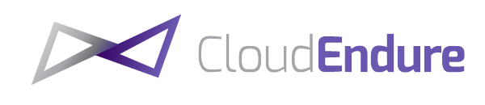

SaaS Applications: Requirements
Product
Subscription API
SaaS offering
Built for Azure
Transact: simple, flat monthly pre-paid billing
99.9% Availability/Uptime
Offer is cancelable by the customer at any time
Host co-branded transaction page where users can manage their account
Map accounts in SaaS service to Azure SaaS subscriptions via the shared context
Notify Microsoft for the subscription management events
Launch Partners

Slide 20
SaaS Subscriptions: User Flow
Azure user
Discover SaaS service
Subscribe to SaaS service
SaaS subscription blade
SaaS landing page
View list of subscribed SaaS services
Create account
Unsubscribe SaaS service*
Change plan
Delete account

Slide 21

SaaS Subscriptions: User Flow API
Discover SaaS service in AzureMarketplace (Azure portal)
Subscribe to a SaaS service in Azure portal
HTTP POST /SaaSLandingPage
SaaS service landing page
X-ms-marketplace-token: “token”
/ResolveCustomer
Create account
Pre-req: Validate
/Subscribe
Change plan
Pre-req: Validate
/Convert
Unsubscribe/delete account
/Unsubscribe

Slide 22
Container Images
Notes:
Main Session:
Open Ibiza, search for a container, deploy a container into AKS

Slide 23
Containers Images
Customer
ISV
What
What
Discovery of container based images applications that have been certified to run on Azure container services
Publish containerized versions of an application
Certified container images: vulnerability-tested and validated on Azure container services
Benefits
Benefits
Build with confidence – start with secure, certified components
Deploy with flexibility – can be deployed to choice of Kubernetes-based container services that run on Azure
Reach developers looking to build and deploy container-based applications
Publish once, run across Azure container services (AKS, ACI, Service Fabric)

Slide 24








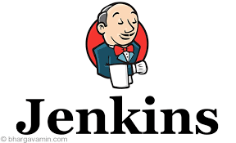










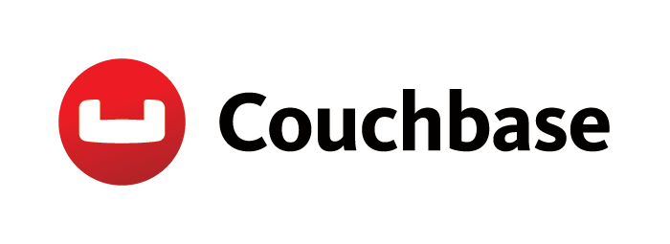





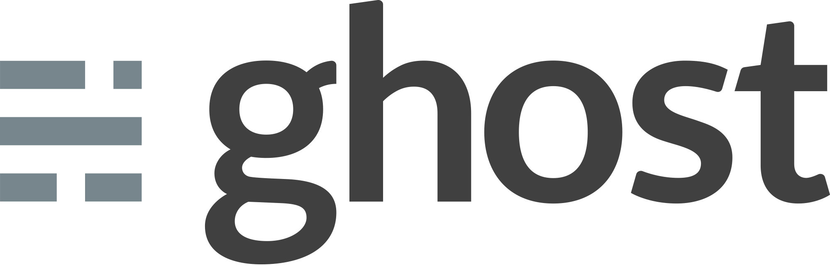




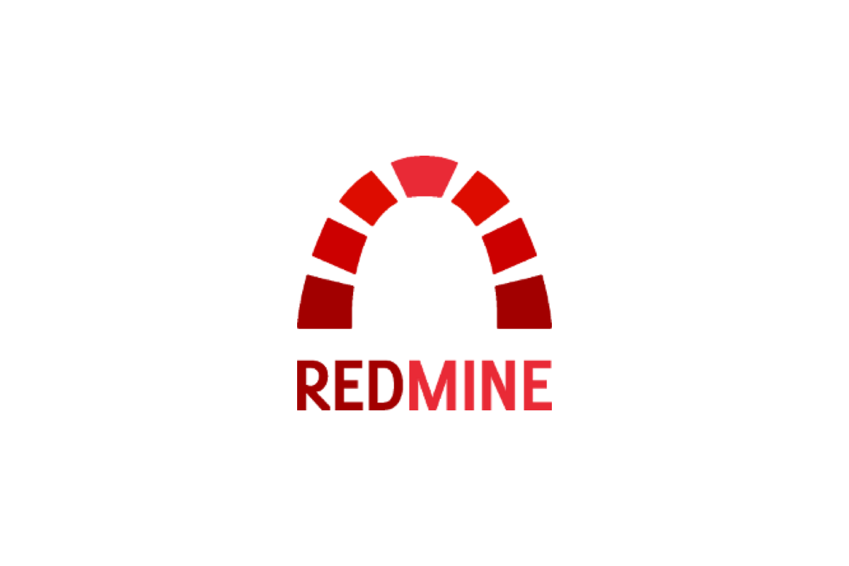






Containers Images at Launch
Web & App Servers
Languages, Frameworks and Tools
Databases
Cache and Search
Standalone Applications

Slide 25
Private Offers

Slide 26
Private Offers
Customer
ISV
What
What
Transact negotiated, off-list pricing with your favorite software providers
Offer Private SKUs with pre-negotiated pricing, terms and images
Benefits
Benefits
Leverage Integrated Billing for private negotiated pricing
Private virtual machine images
Simplify Enterprises Software Procurement
Provide differentiated offers to target customers
Leverage Azure Billing to easy customer journey to the cloud
Run Private Early Access Programs

Slide 27



Private Offers: 3 Steps to custom deals
1
ISV and Customer Negotiate Pricing, Terms and Custom Image
2
ISV Creates Private SKU in Publisher Portal
3
Customer gets Private Offer in Azure Portal
Launch Partners

Slide 28
Consulting Services

Slide 29
Consulting Services
Customer
SI/MSP
What
What
Search Partners offers for Azure education, optimization, and implementation
Request Partner to contact
List Services for Azure Customers
Showcase and differentiate your current portfolio of offerings
Benefits
Benefits
Immediate access to validated expertise
Tailored assistance on your journey to the cloud
Optimize your cloud investments quickly and securely
Leverage Marketplace as a new channel
Leverage Azure Sponsorship for new Azure customer recruitment
Differentiate your service to the market and to the Microsoft field

Slide 30
Publishing a Consulting Service Offer Now live in the United States
Partner Competencies
SI/MSP with MPN Silver or Gold Cloud Platform Competencies
Offer Type
Assessment
Briefing
Implementation
Proof of concept
Workshop
Application Development and ISV
Cloud Infrastructure and Management
Offer Structure
Data Management and Analytics
Fixed price or free
Fixed duration
Pre-defined scope
Defined outcome
Notes:
> Live in the United States
> Canada, UK, Australia are next.

Slide 31
Wrapping Up

Slide 32
In Review
Organizations and Users are adopting cloud marketplaces
Marketplace is a unique opportunity for ISVs and SIs
Partners can List, Trial, or Transact in marketplace
Marketplace is evolving with continued investments addressing new audiences, offer types and more commerce scenarios

Slide 33
Get Started
Get Started
Learn
Read Marketplace Publisher Guide
Apply
Submit to Azure Marketplace or AppSource
Create
Register as a publisher and build the offer
Publish
Preview, test,
and go live
Grow
Use Go-To-Market services to grow your business
Resources
Appsource.com
Azuremarketplace.com
Aka.ms/marketplacepublisherguide
Aka.ms/listonazuremarketplace

Slide 34
THANK YOU Q&A

